Slide 1

$e^{+}−π^{+}$ Electromagnetic Calorimeter shower classification
Validation of the machine learning approach on the LHCb use case
Tigran Ramazyan
Eugeny Gurov
Daniil Sobolev
Fall 2022

Slide 2
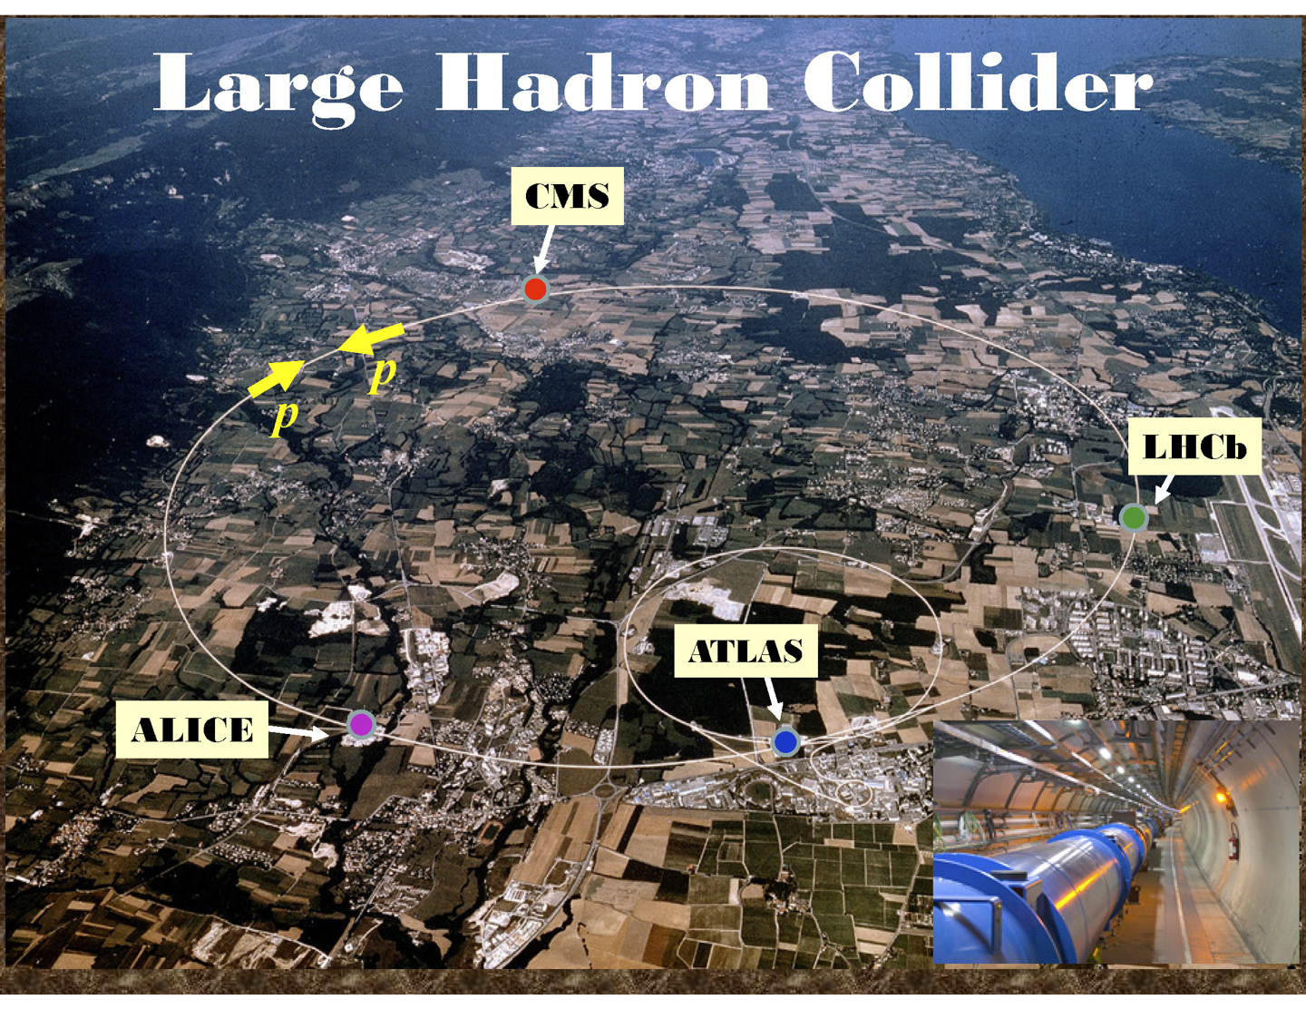
The LHC

Slide 3
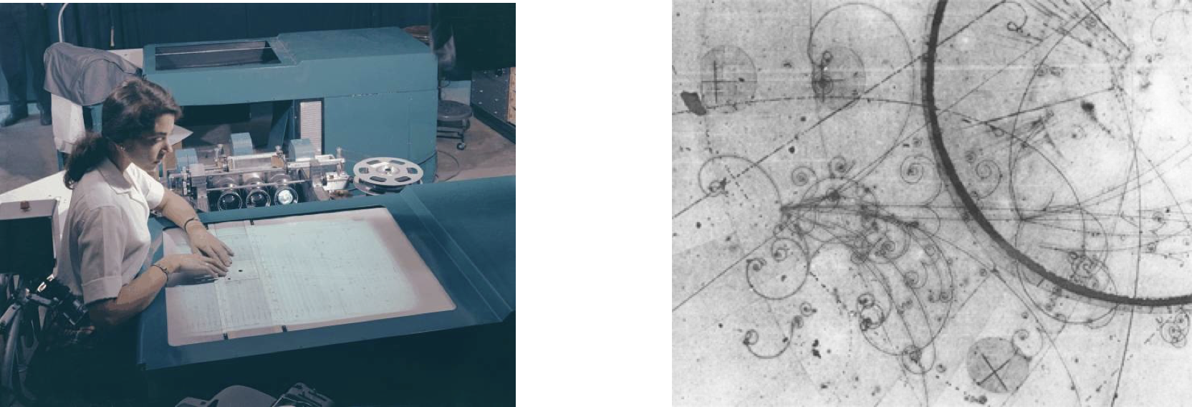
Everything was simpler before…
A camera was triggered manually and events were analysed manually.

Slide 4
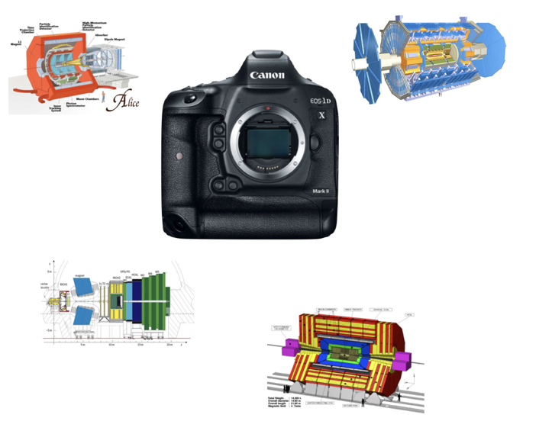
HEP Detectors
many layers of sensors: ∼200 sq.m. matrices
resolution: ∼100М pixels
photo speed: 40 000 000 photos per second
record: 200-1000 photos per second
work for many years

Slide 5
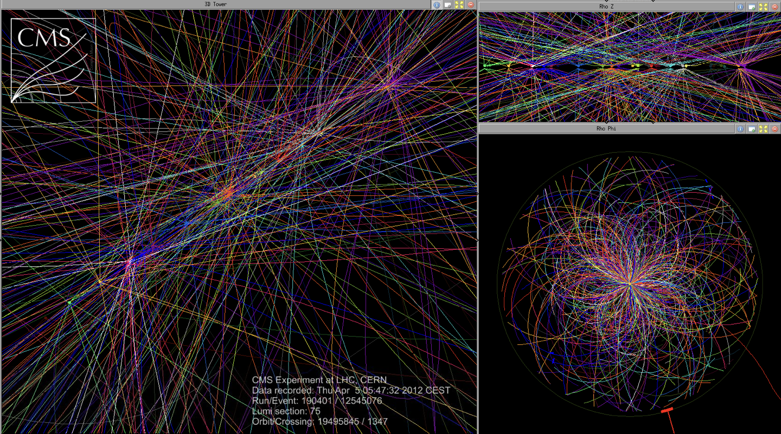
LHC events today
We evidently cannot do without machine analysis, e.g., CV or ML, anymore

Slide 6
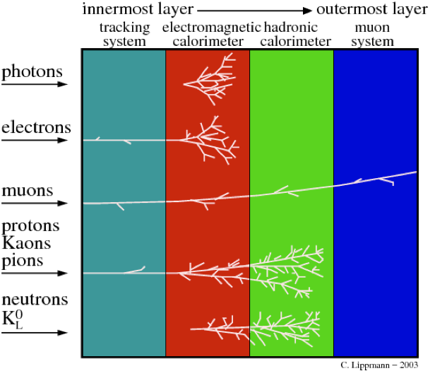
How an event looks like
Detectors normally include several subdetectors that react differently on the incident particle.
Notes:
Correctly identifying the nature and properties of particles produced at the Large Hadron Collider is a crucial task for fully exploring subnuclear length scales in search of new physical phenomena. The final project will address the active research problem of object identification in the context of elementary particles interacting with a multi-layer, heterogeneously-segmented electromagnetic calorimeter

Slide 7
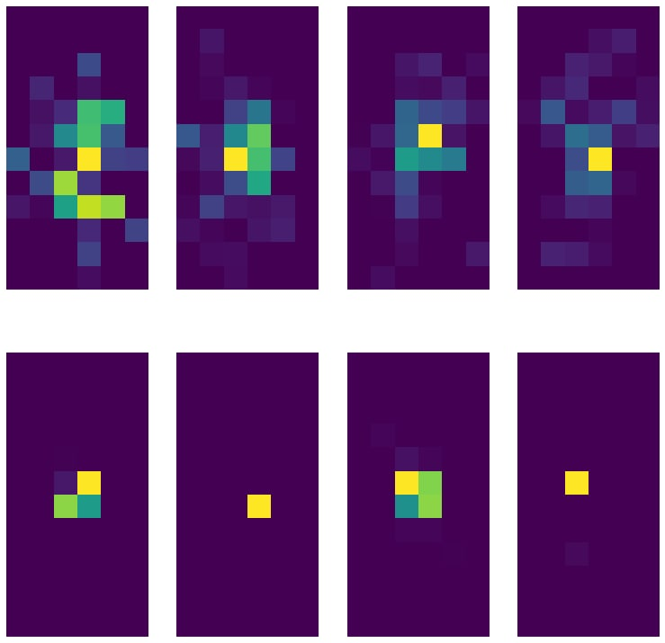
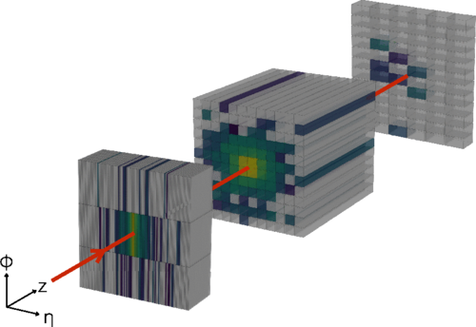
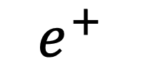
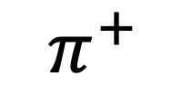
Examples of data: single calorimeter layer
$$e^{+}$$
$$π^{+}$$

Slide 8

Expected tasks and results
Implement CV methods for $e^{+}−π^{+}$ classification on calorimeter images
Compare CV solutions with ML solutions
Although a CV approach may yield a decent result, it still would be significantly worse than a ML model

Slide 9
Template matching
Particle showers have unique shapes;
However shower shapes encapsulate physical characteristics of the particle, e.g., interaction with the electromagnetic field of the detector;
Averaging over a number (N) of images may give us a template for the corresponding to a particle shower shape;
N = 100 has shown to yield the best result with accuracy 0.532.
N | 10 | 10² | 10³
Accuracy | 0.449 | 0.532 | 0.416
 | PP | NP
P | 0.204 | 0.296
N | 0.172 | 0.328
Confusion matrix for template matching solution.

Slide 10
Thresholding
Both pions and positrons have highly luminated central pixels;
Positrons have a significantly large number of luminated pixels outside the central 2x2 pixels;
We may classify the images based on the number (N) of luminated pixels outside the central 2x2 pixels;
N = 1 has shown the best result with accuracy 0.617.
 | PP | NP
P | 0.467 | 0.033
N | 0.350 | 0.150
Confusion matrix for thresholding solution.

Slide 11
Largest Contour Area Classification
Continuing the idea from the previous slide, we could classify showers by the area of the largest contour
For pions these areas should be at most 4
For positrons most of the events should have the largest contour area much greater
Area threshold | 3 | 4 | 5 | 6 | 7 | 8
Accuracy | 0.575 | 0.562 | 0.549 | 0.536 | 0.522 | 0.508
 | PP | NP
P | 0.382 | 0.118
N | 0.307 | 0.193
Confusion matrix for largest contour area classification with area threshold 3.

Slide 12
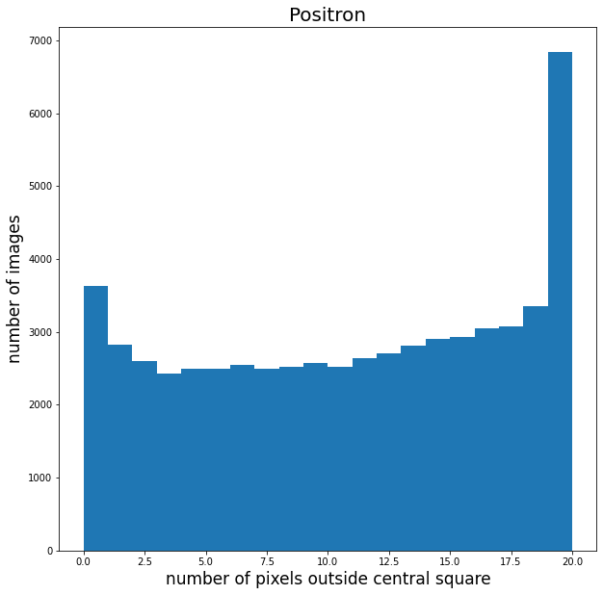
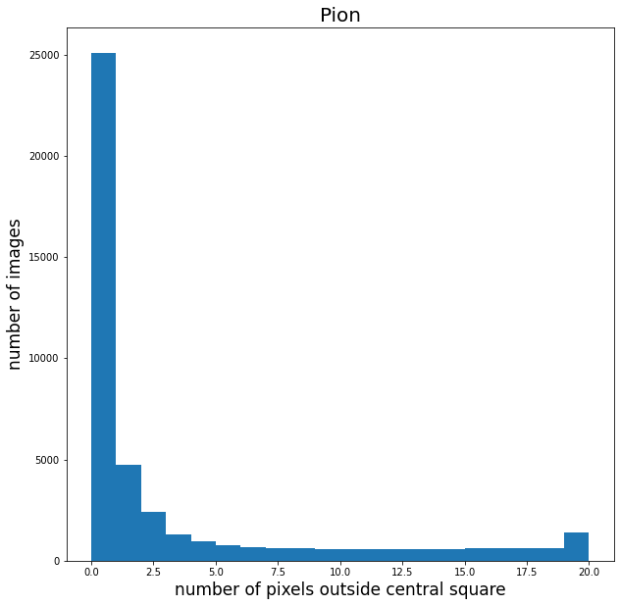

Slide 13
ML Solutions: CNN
Several CNN architectures have been examined for this task
Several (3-4) Conv2d layers followed by (1-2) fully connected layers
All of them have failed training due to a large amount of non-significant values (zero pixels) and have yield ‘random classifier’ results, i.e., accuracy of ~0.5
Transformations such as CenterCrop have not make any significant improvement
However, the method currently in production is a DenseNet-based NN with 99.99% accuracy.

Slide 14
ML Solutions: CatBoost
“Gradient boosting is also utilized in High Energy Physics in data analysis. At the Large Hadron Collider (LHC), variants of gradient boosting Deep Neural Networks (DNN) were successful in reproducing the results of non-machine learning methods of analysis on datasets used to discover the Higgs boson.” ^{[1]}
CatBoost handles well low dimensional data (images are 12x6, i.e., 72x1 vectors)
The model has shown the best result with accuracy of 0.985
 | PP | NP
P | 0.496 | 0.004
N | 0.011 | 0.489
Confusion matrix for CatBoost.
[1] https://en.wikipedia.org/wiki/Gradient_boosting

Slide 15
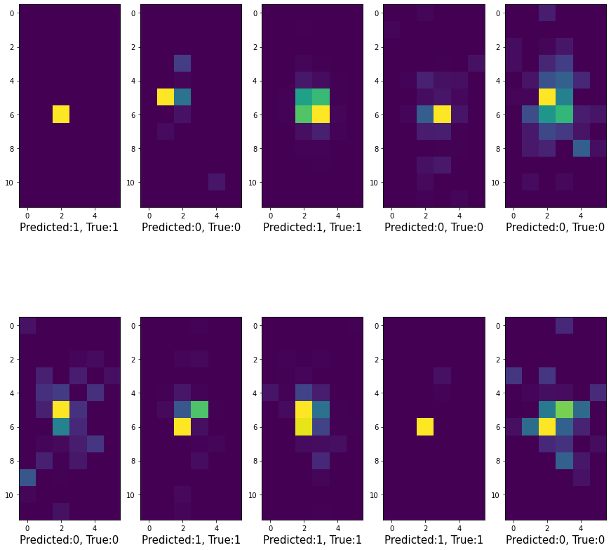
CatBoost well predicted example

Slide 16
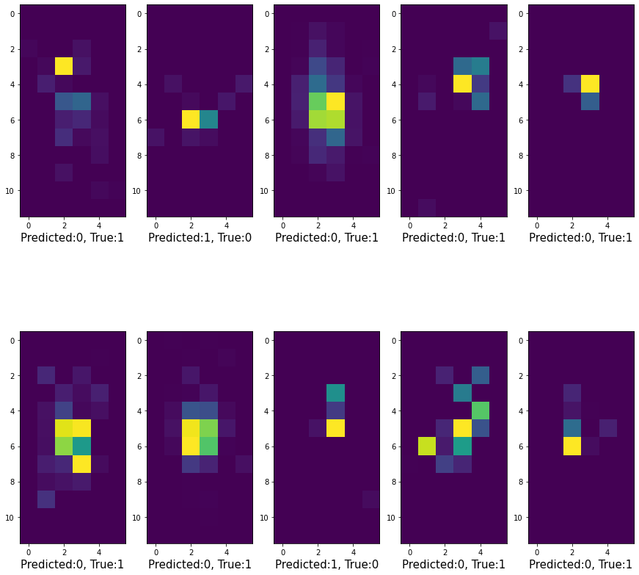
CatBoost misprediction examples

Slide 17

Conclusion
Several CV methods have been tested as solution for the $e^{+}−π^{+}$ electromagnetic calorimeter shower classification.
Although they may be extended into more precise solutions, a plug-and-play GB solution yields a result close to the state-of-the-art model.

